Slide 1
Classifying Knee X-rays
Identifying the severity of knee osteoarthritis in x-ray images

Slide 2


Fast Facts about Knee Osteoarthritis (OA)
Most common type of arthritis
Impacts quality of life, can be debilitating
Affects over 32.5 million adults in the USA
240 cases per 100,000 adults each year
Symptoms in 1 in 3 obese adults
No cure
Early identification is key to slowing the progression of OA

Slide 3


Data Source
Kaggle: Knee Osteoarthritis Dataset with Severity Grading
Mendeley Data (Chen, Pingjun (2018), “Knee Osteoarthritis Severity Grading Dataset”, Mendeley Data, V1, doi: 10.17632/56rmx5bjcr.1)

Slide 4
Kellgren-Lawrence (KL) scale
Grade 0 (None): No pathological features, i.e. a healthy knee image
Grade 1 (Doubtful): Doubtful joint narrowing with possible osteophytic lipping
Grade 2 (Minimal): Definite presence of osteophytes and possible joint space narrowing
Grade 3 (Moderate): Multiple osteophytes, definite joint space narrowing, with mild sclerosis.
Grade 4 (Severe): Large osteophytes, significant joint narrowing, and severe sclerosis.

Slide 5
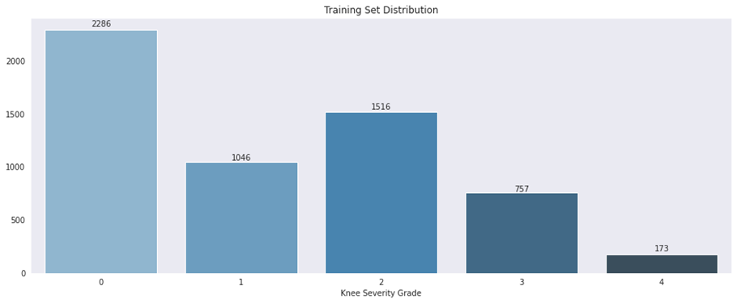
Imbalanced Data

Slide 6


Modeling
Keras Image Classification
Transfer Learning : DenseNet201 initialized with ImageNet weights
Fine-tuning

Slide 7
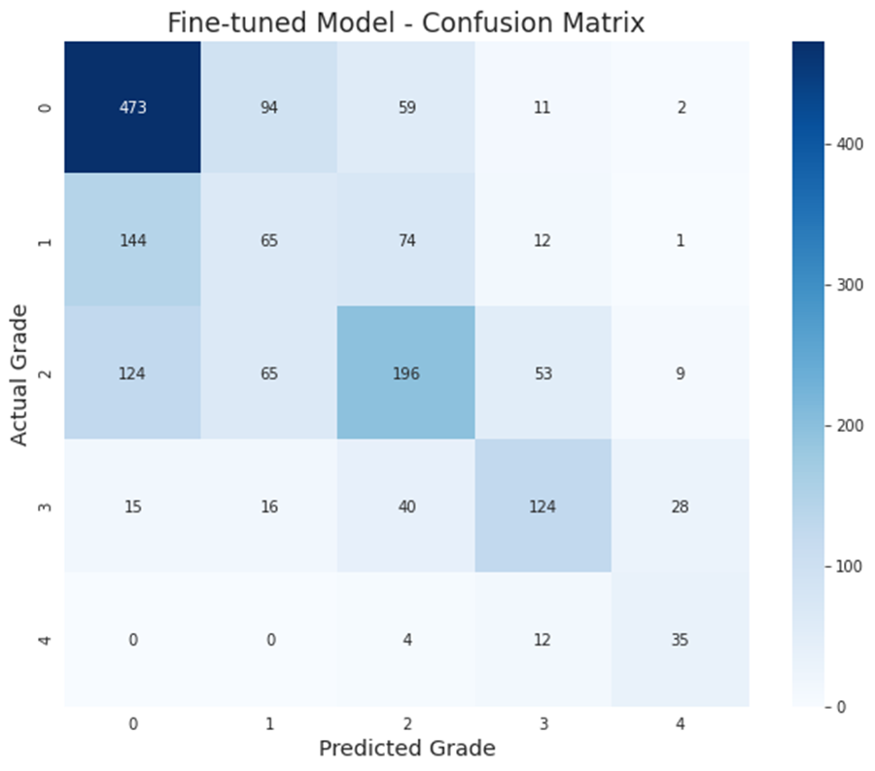
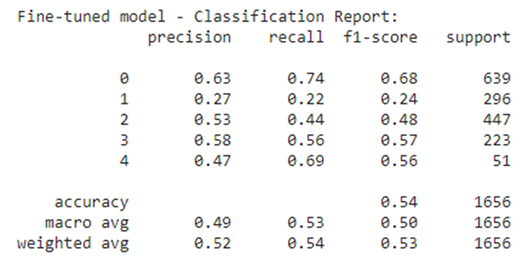
Modeling – 5 Grades on the KL-Scale Accuracy = 54%

Slide 8
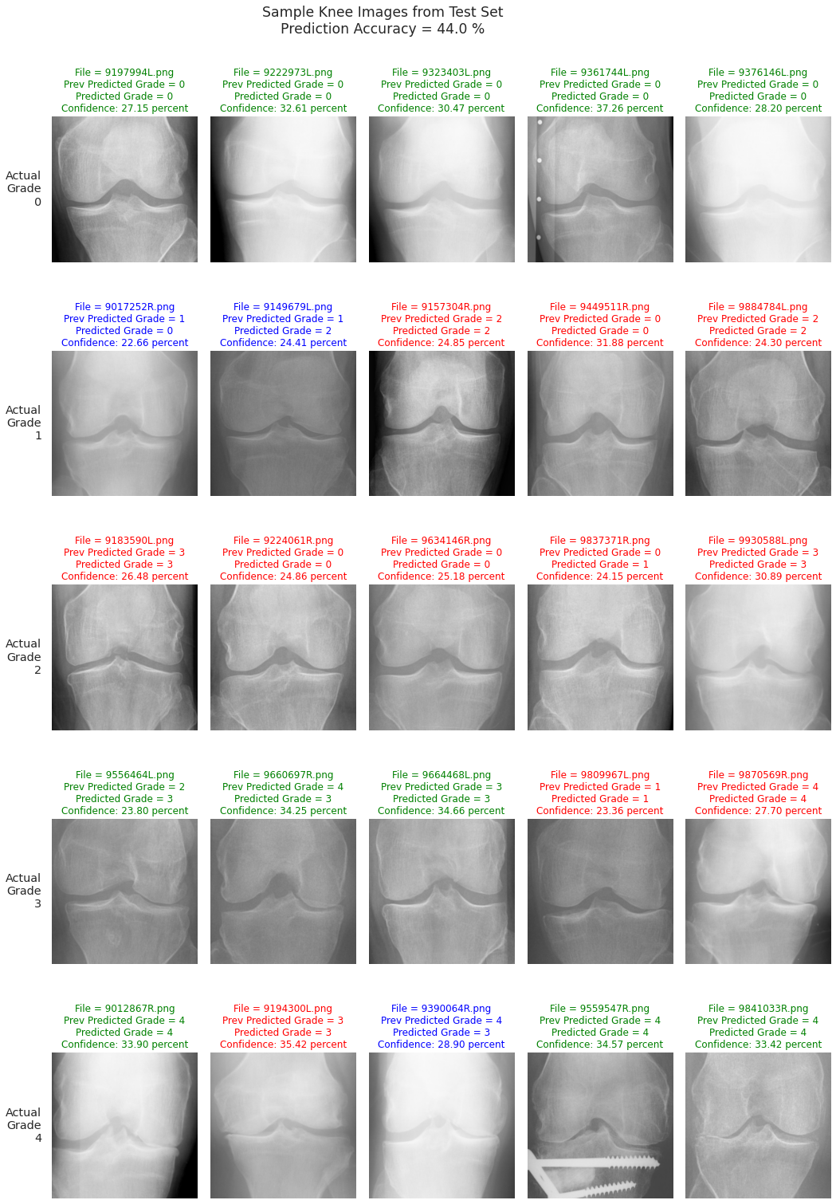
Sample Knee Images from Test Set (Grade 0-1) Prediction Accuracy = 44%

Slide 9
Sample Knee Images from Test Set (Grade 2-4) Prediction Accuracy = 44%

Slide 10
Simplifying into 3 classes
A : Grades 0 (None) and 1 (Doubtful) : a reasonably healthy knee, patient with knee pain may wish to explore other causes
B : Grade 2 (Minimal) : patient has minimal OA and should consider lifestyle changes, and possibly medication
C : Grades 3 (Moderate) and 4 (Severe) : knee replacement and other procedures and/or surgeries may be an option

Slide 11
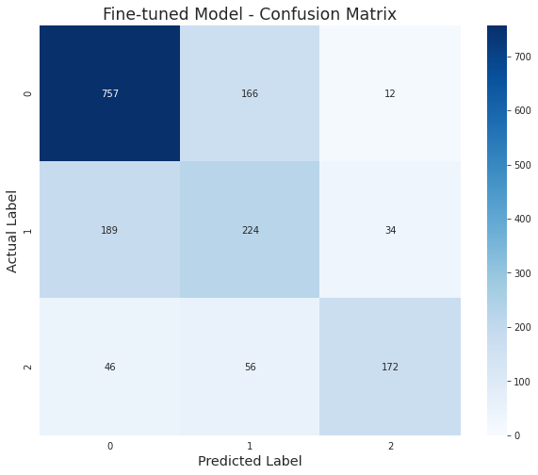
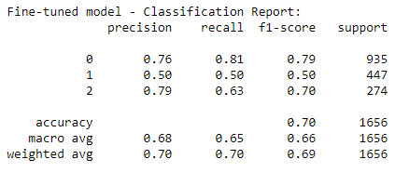
Modeling – Simplified 3 Classes Accuracy = 70%

Slide 12
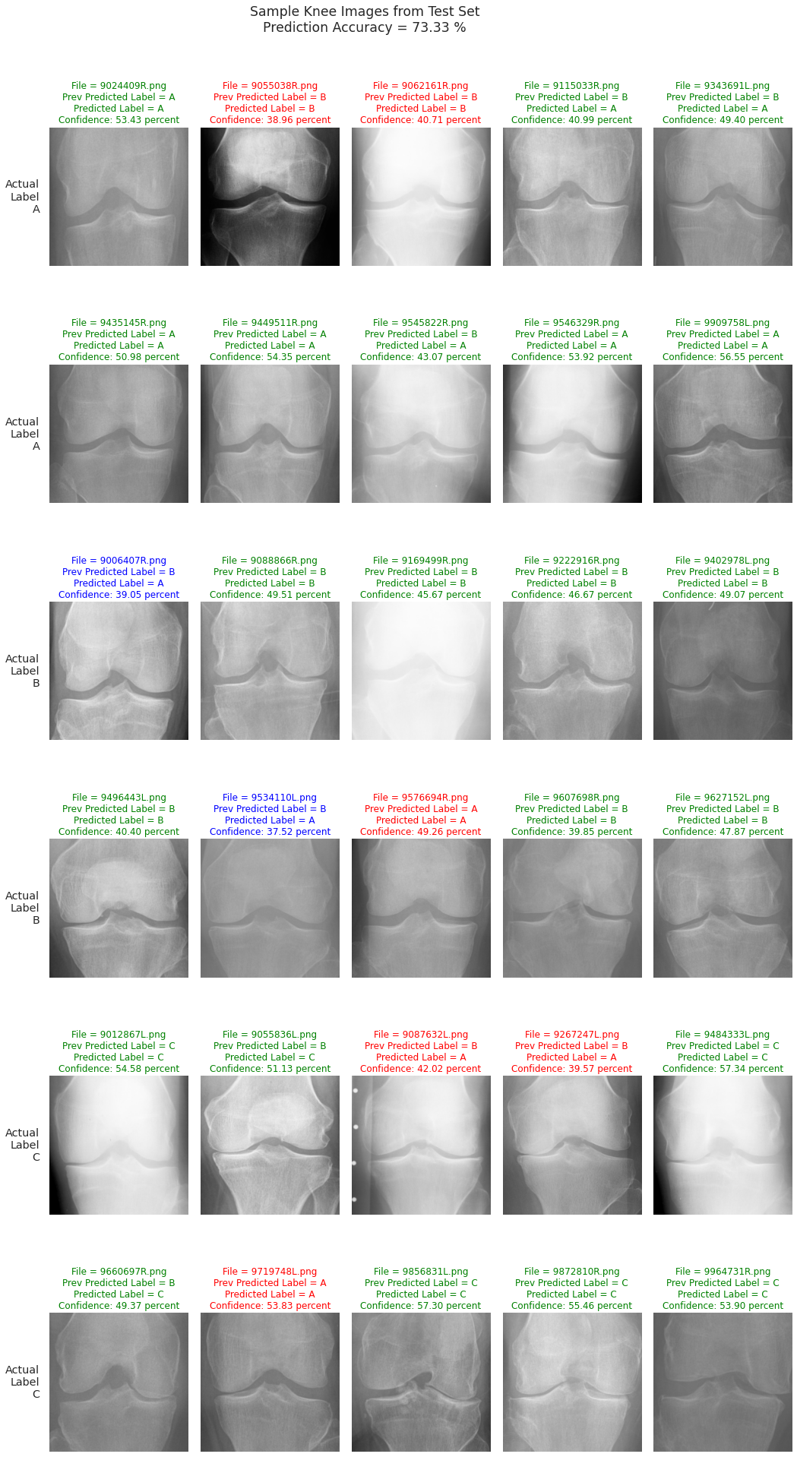
Sample Knee Images from Test Set (Class A) Prediction Accuracy = 73.33 %

Slide 13
Sample Knee Images from Test Set (Class B) Prediction Accuracy = 73.33 %

Slide 14
Sample Knee Images from Test Set (Class C) Prediction Accuracy = 73.33 %

Slide 15
Further Research
Explore other methods of identifying knee OA from X-rays
1
Improve model – add more labeled images to training set
2
Additional fine-tuning, targeting grade 2 / class B classification
3

